Slide 1

Introducing the EARN Code Library
Sebastian Martinez Hickey

Slide 2
Thank you to Logan Rockefeller Harris and Patrick McHugh from the North Carolina Budget and Tax Center!

Slide 3
What is the EARN Code Library?
Code repository on the EARN website
Explore and download Stata and R work by other EARN researchers
Upload your own projects you want to share with the network

Slide 4
Why create a code library?
Generate and share ideas for research projects
Make data analysis more accessible and efficient

Slide 5
Components of a code library entry
Description
Code file(s)
Supplementary data
Output example

Slide 6
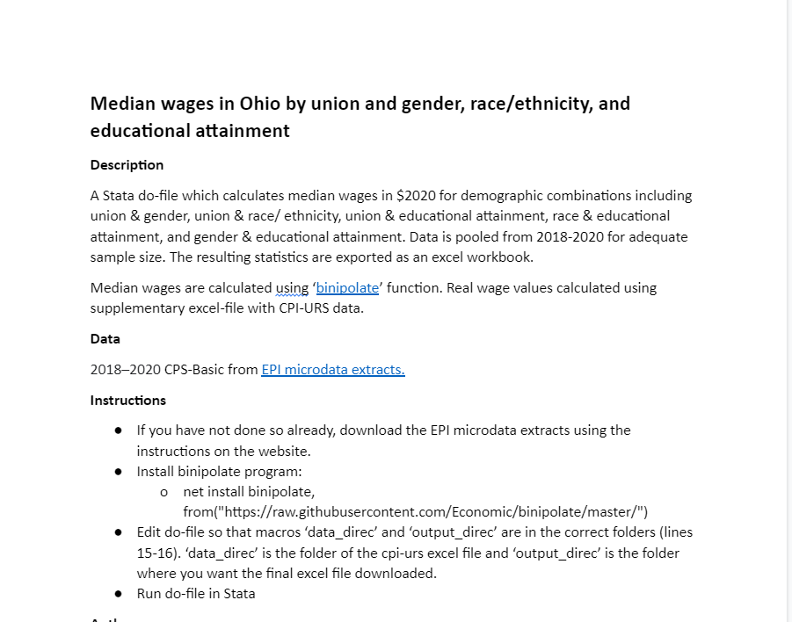

Slide 7
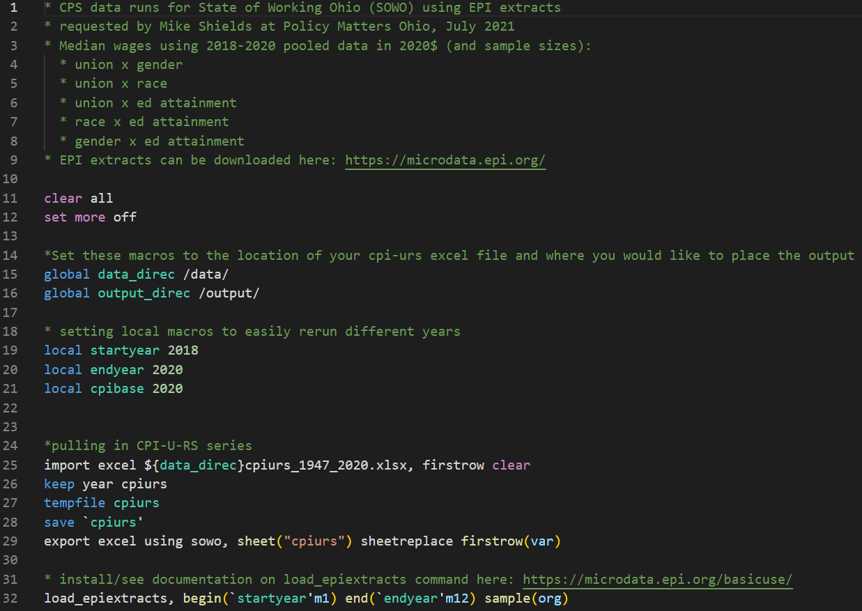

Slide 8
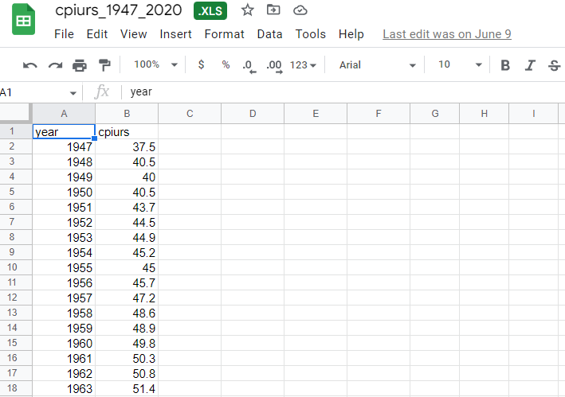

Slide 9
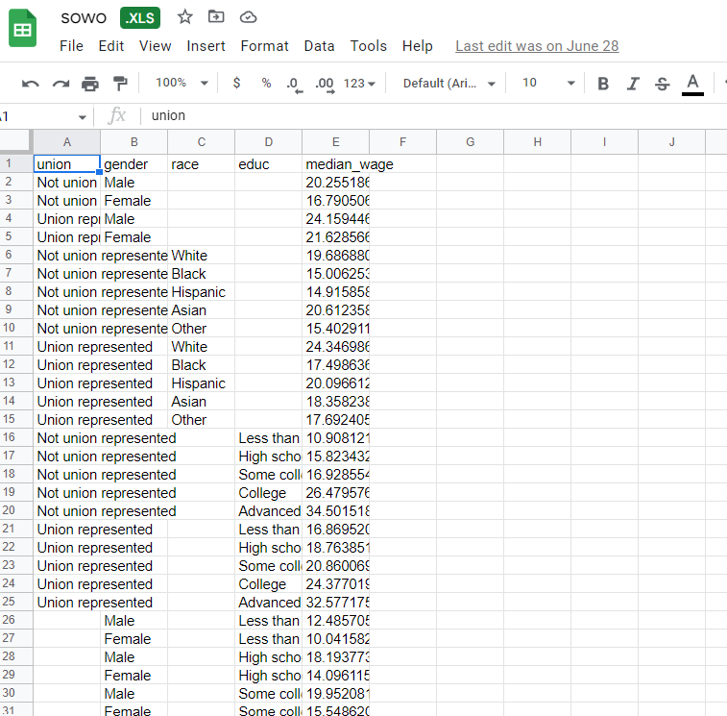

Slide 10
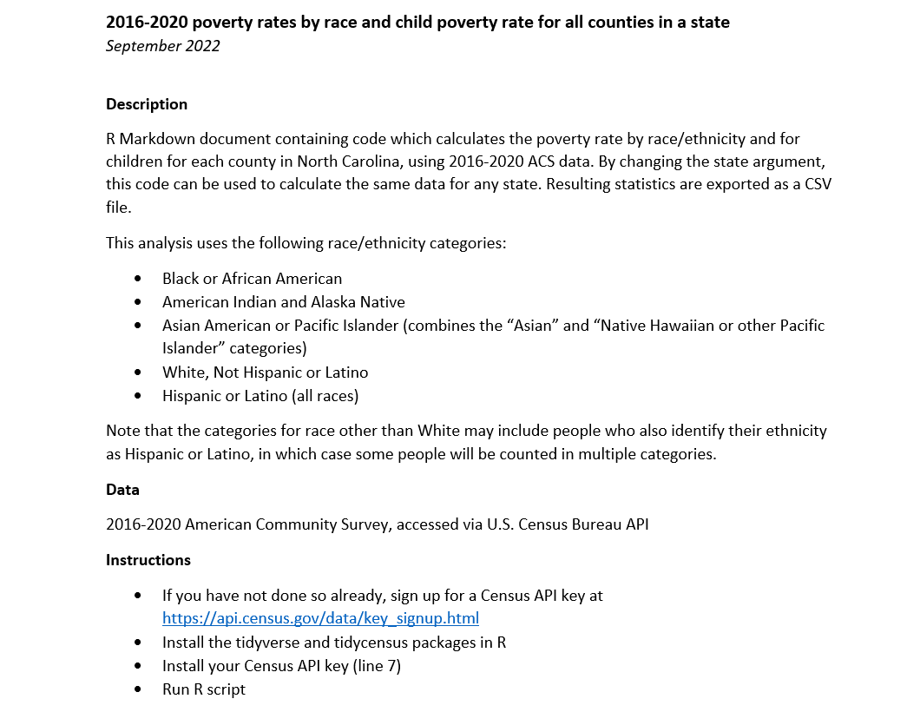

Slide 11
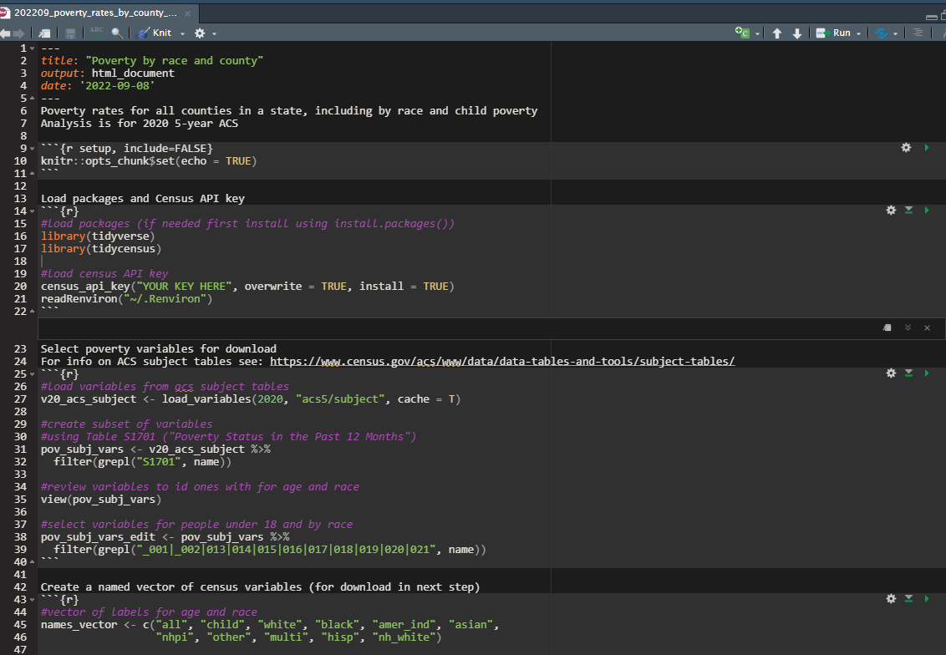

Slide 12
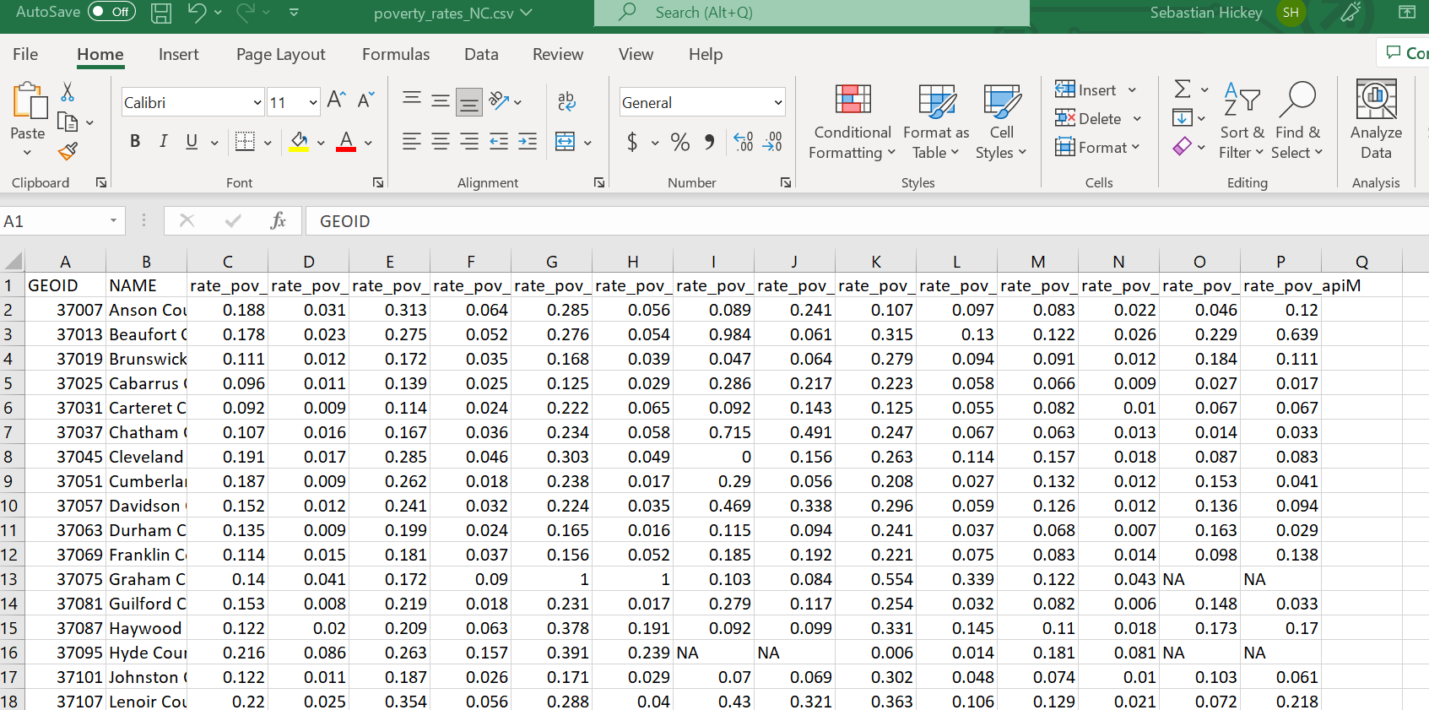

Slide 13
Uploading content to the library
Timeline for website publication: End of 2022
EARN researchers send projects with all 4 components
EARN staff assist in preparing projects for publication on the website
Code authors agree to include their contact information in descriptions

Slide 14
My contact info:
Sebastian Martinez Hickey – shickey@epi.org

